Slide 1
Lending Club Case Study
Parmod

Slide 2
Objective
The object of this case study is to find which types of loans have been defaulted in the Past and implement EDA to understand how consumer attributes and loan attributes influence the tendency of default. The aim is to identify patterns which indicate if a person is likely to default, which may be used for taking actions such as denying the loan, reducing the amount of the loan, lending (to risky applicants) at a higher interest rate, etc.
Insights and observations from the analysis
Understand the driving factors (or driver variables) behind loan default
Utilise this knowledge for its portfolio and risk assessment.

Slide 3
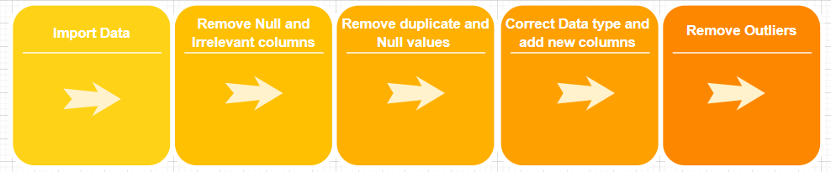
Business Decision
The business analysis is to take a decision wether they need to approve the loan application or to reject based on driving variables.
Dataset Details:
We have a loan dataset from year 2007-2011 and we need to correct the data through EDA process and analyze the loan status wrt to other driving columns.
EDA Proccess :

Slide 4
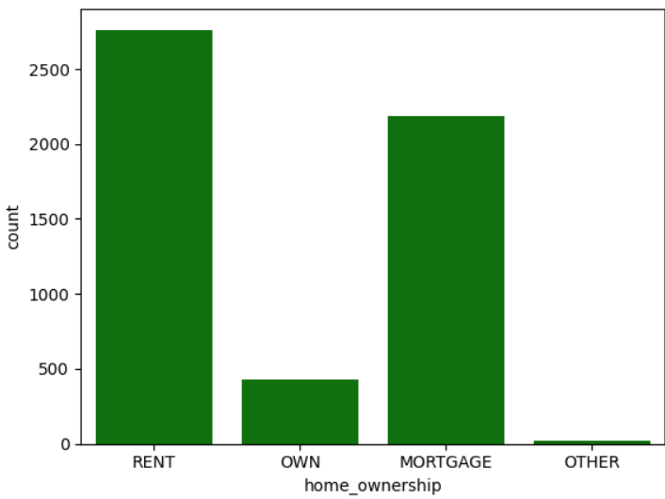
Loan Status and Home Ownership
Home Ownership: Applicants those having the Rent house considering for default loans

Slide 5
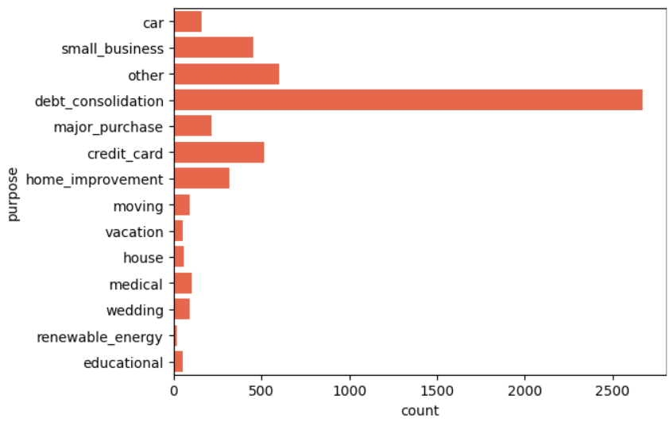
Loan Status and Loan Purpose
Loan Purpose: The Loans taken for ‘debt consolidation’ purpose are much chance of defaulting.

Slide 6
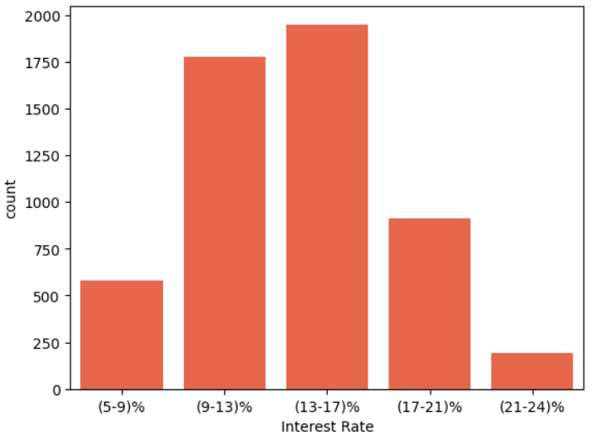
Loan Status and Interest Rate Groups
Interest Rate Groups: The Loans taken on ‘(13-17)%’ interest rate are much chance of defaulting.

Slide 7
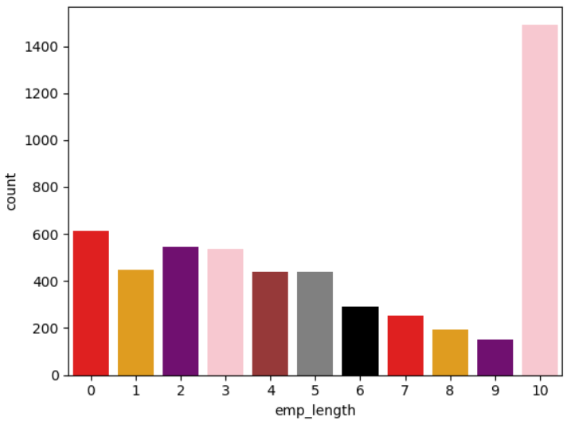
Loan Status and Employment Length
Employment Length: The Loans taken by application who have ‘10 years’ employment length are much chance of defaulting.

Slide 8
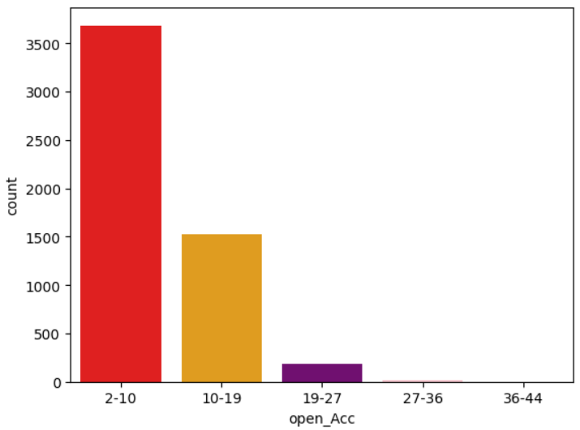
Loan Status and Open Account
Open Account: The Loans taken by application who have ‘2-10’ open acc are much chance of defaulting.

Slide 9
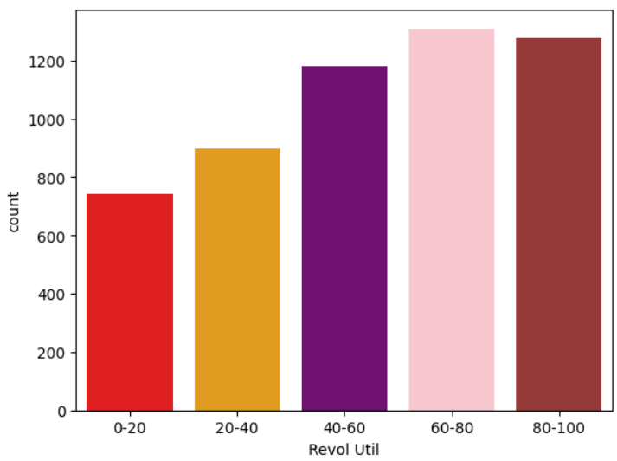
Loan Status and Revol Util
Revol Util: The Loans taken by application who have ‘60-80’ revol util are much chance of defaulting.

Slide 10
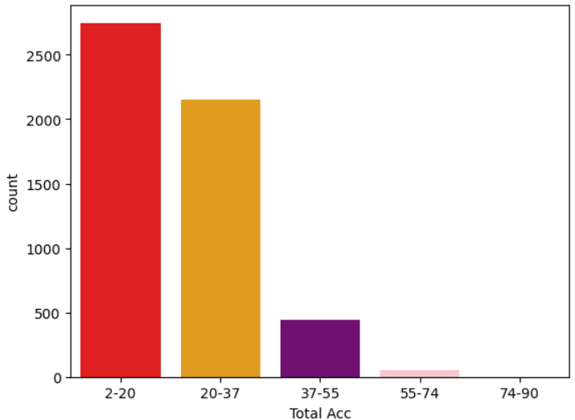
Loan Status and Total Account
Total Account: The Loans taken by application who have ‘2-20’ total acc are much chance of defaulting.

Slide 11
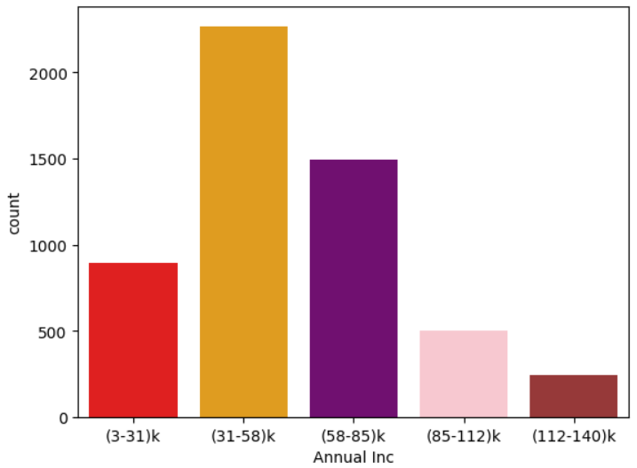
Loan Status and Annual Income
Annual Income: The Loans taken by application who have ‘(31-58)k’ annual income are much chance of defaulting.

Slide 12
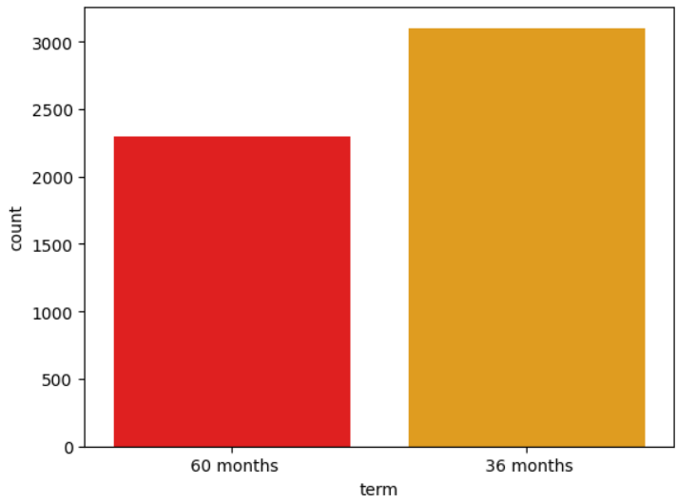
Loan Status and Terms
Terms: The Loans taken by application for ‘36 months’ terms are much chance of defaulting.

Slide 13
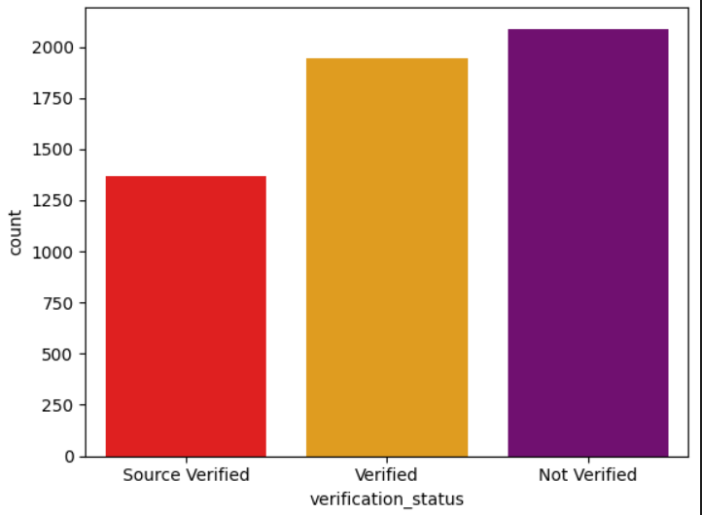
Loan Status and Verification Status
Verification Status: The Loans taken by application who have ‘Not Verfied’ verification status are much chance of defaulting.

Slide 14
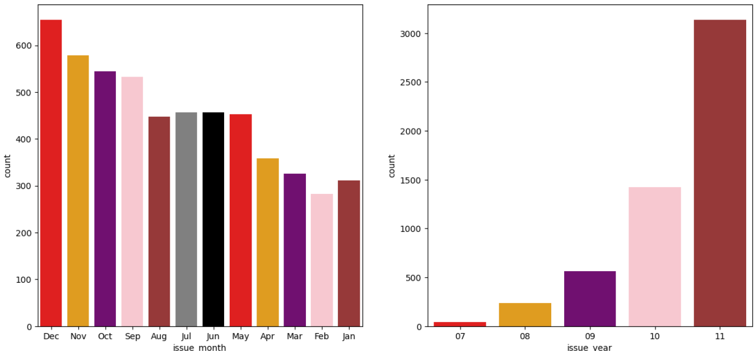
Loan Status and Issue Date
Issue Month: The Loans issue in ‘December’ month are much chance of defaulting.
Issue Year: The Loans issue in ‘2011’ year are much chance of defaulting.

Slide 15
Observations
There is a more probability of loan defaulting when:
- Applicants having house_ownership as 'RENT'
- When the loan purpose is 'debt_consolidation'
- Applicants receive interest at the rate of 13-17%
- Applicants have an income of range 31201 - 58402
- Applicants have 2-10 open_acc
- Applicants with employement length of 10 in years
- When funded amount by investor is between (5-10)k
- Loan amount -> between 5429 - 10357 (5-10)k
- When monthly installments are between 145-274, Term of 36 months
- Loan status is Not verified, Number of enquiries in last 6 months is 0
- Number of derogatory public records is 0, Grade is 'B', Sub grade of 'B5' level.
- Dti is in between 12-18
- Maximum Loans are defaulted when loan approve in December month and year 2011.
- When revol_util is between 60-80, Whe total_acc is between 2-20
- When annual_inc is between (31-58)k

Slide 16
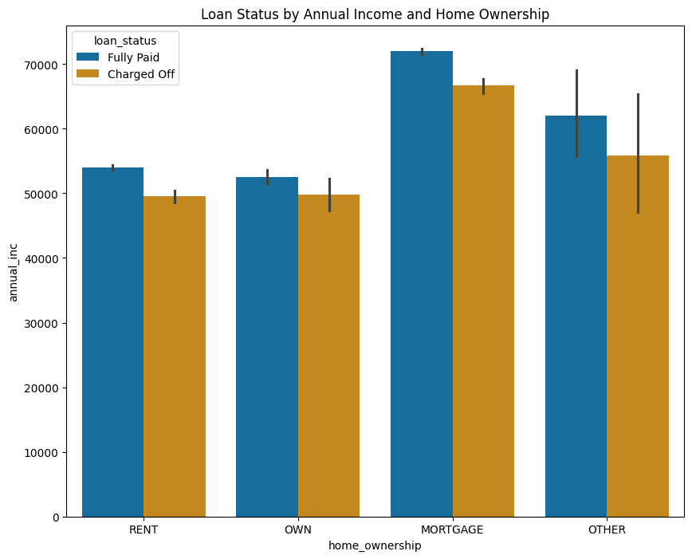
Loan Status by Annual Income and Home Ownership
Annual Income and Home Ownership: The Loans taken by application who have (60-70)k annual income and ‘Mortage’ home ownership are much chance of defaulting.

Slide 17
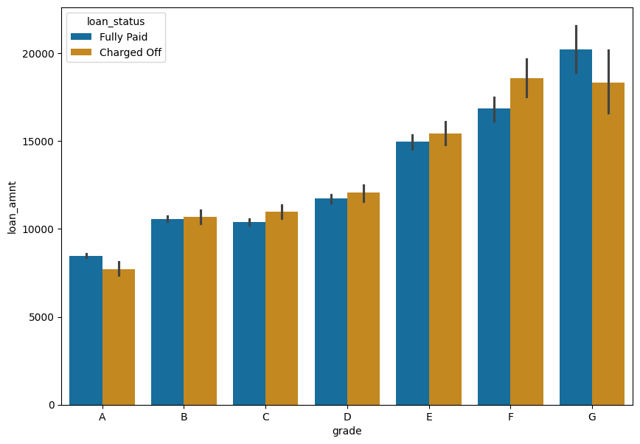
Loan Status by Annual Income and Grade
Annual Income and Grade: The Loans taken by application who have (15-20)k annual income and ‘G’ Grade much chance of defaulting.

Slide 18
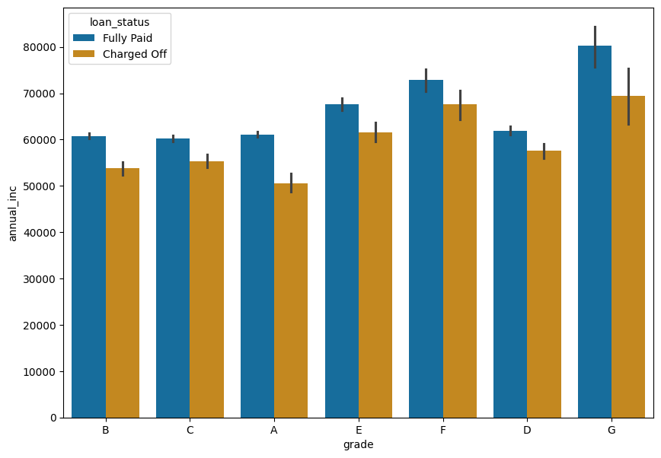
Loan Status by Annual Income and Home Ownership
Annual Income and Grade: The Loans taken by application who have (60-70)k annual income and ‘G’ grade are much chance of defaulting.

Slide 19
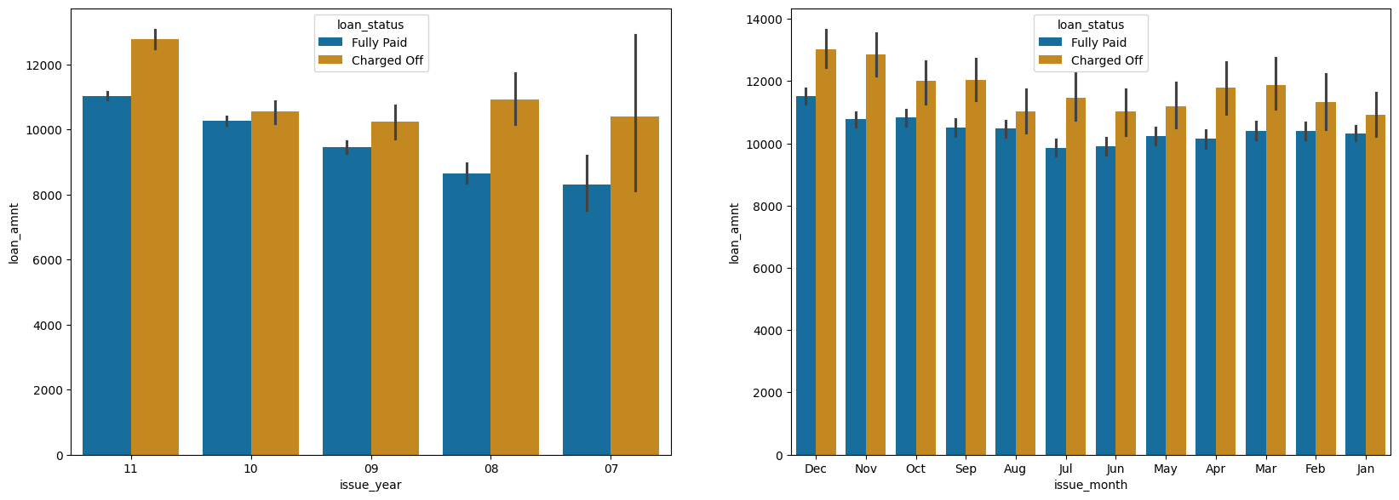
Loan Status by Annual Income and Issue Date
Loan Amount and Issue year: The Loan amount > 12k and issue in ‘2011’ year are much chance of defaulting.
Loan Amount and Issue Month: The Loan amount (12-14)k and issue in ‘December’ month are much chance of defaulting.

Slide 20
Analysis and Observations for future loan defaulting
From above analysis of other columns wrt charged off loans. Probability of defaulting when:
-- Loan purpose 'home improvement' and an annual income of (60-70)k
- Home ownership is 'MORTGAGE and have income of (60-70)k
- Annual Income groups (112-140)k and Loan amount 17500-20000
- Interest at the rate of 21-24% and an annual income of (70-80)k
- Grade is 'G' and annual income of (70-80)k
- Loan amount group (30-35)k and are interest rate of (15.0-17.5) %
- Loan purpose for small business and the loan amount>14k
- Home ownership is 'MORTGAGE' and loan amount of (14-16)k
- Loan issue year 2011 and loan amount > 12k
- Loan issue month December and loan amount>(12-14)k
- Grade is F and loan amount is between (15-20)k
- Employment length is 10 years and loan amount is (12-14)k
- Loan verification status is 'Verified' and loan amount is > 16k

